Slide 1
CONFLUENCE
Presented by :
Karanvir Kaur
Web Team

Slide 2
Topics:
Introduction
Log in
Create Page
Edit Page
Page view mode
Upload files
recommendations
Space permissions

Slide 3
Confluence
Confluence is an online application built to help teams organize, discuss, and do their work
is a powerful tool which organizes our work in spaces.
Spaces are made up of pages. Pages are the documents in which your team will create, edit, and discuss work
https://www.atlassian.com/collaboration/confluence-organize-work-in-spaces
Note : Confluence is not designed to be a document management or file sharing system for documents which are created offline. Instead, it focuses on features that improve the editing and sharing online content created within itself but also includes the ability to store and organize attached files with version history.

Slide 4
Space
Spaces are Confluence's way of organizing content into meaningful categories. Think of them like different folders where you can store your work.

Slide 5
Log In
Link to Confluence http://webdocs.rch.org.au:8090/
On RCH website you will click on staff resources then under “C”, you will see confluence link.
You can login using your window username and password.

Slide 6
Create Page
If you want to quickly create a blank page, hit the Create button in the header; if you want to create a page from a template, hit the Create from template button.
Create blank page
Create from template

Slide 7
Create From Template
Select space: choose the space where you'll create the content.
Page templates: create a page from a template or create other types of content.
Parent page: your page will be a child of this page.

Slide 8
Templates
These are the templates that come with Confluence:
Decision: Record important project decisions and communicate them with your team.
How-to article: Provide step-by-step guidance for completing a task.
File list: Upload, preview, and share files with your team.
Jira report: Communicate Jira information in easy to read reports
Meeting notes: Plan your meetings and share notes and actions with your team.
Retrospective: What went well? What could have gone better? Crowdsource improvements with your team.
Product requirements: Define, track, and scope requirements for your product and feature.
Share a link: Share and discuss content from the web like articles and videos with your team.
Task report: Keep track of tasks for your team or project.
Troubleshooting article: Provide solutions for commonly encountered problems.
https://confluence.atlassian.com/confcloud/blueprints-and-user-created-templates-724764985.html

Slide 9
Page view mode
Confluence header: create blank pages, pages from templates and visit spaces or your profile.
Space sidebar: access pages, blogs and administer the space.
Page tools: edit or share the page, watch it to get updates and perform more actions.

Slide 11
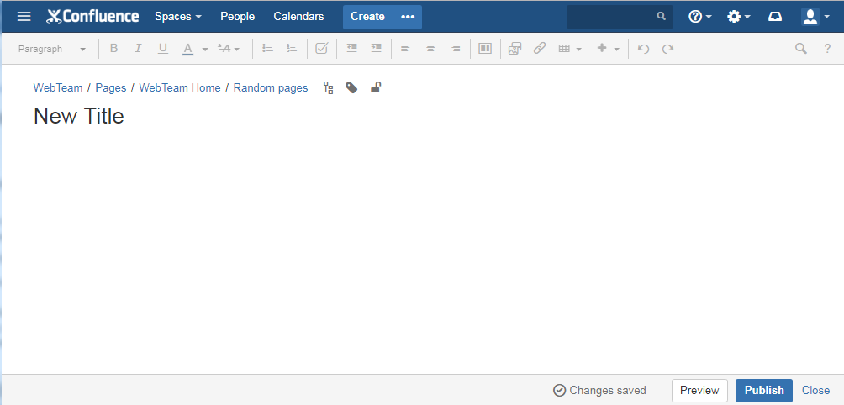
Edit Page
To Edit page:
Click on Edit button.

Slide 12
Upload Files
When you upload a file, such as an image or document, it will be attached to the current page. To upload a file you'll need the 'Add Attachments' space permission.
There are many ways to attach a file to a page.
In the editor you can:
Drag the file directly onto the page.
Go to Insert > Files and images and upload a file.
When viewing a page you can:
Drag the file directly onto the page.
Go to > Attachments and upload a file.
You can attach multiple files at a time.

Slide 13
File versions
If you upload a file with the same name as an existing attachment on the same page, Confluence will overwrite the existing attachment. Confluence maintains version history for all attachments. For more information, see Manage files.
Changes you make to the source file won't affect attachments in Confluence. To update a file you've attached to a Confluence page, upload a new version of the file.

Slide 14
You should upload documents only if
You have legacy content
You have vendor manuals or supplied content
Content of file can not be managed in Confluence page effectively (for e.g. large Excel sheets)
Recommendations
size less than 10 MB
Note: Confluence is a collaborative tool to create content online and creating a effective workflow. So try to make pages in confluence rather than creating offline MS Word files and then uploading it to confluence.

Slide 15
Watch a Confluence Page
You can 'watch' a Confluence page, blog post or space. Confluence will then send you a notification email whenever anyone updates your watched content.
You'll receive email notifications for:
Edits (unless the author clears the 'Notify watchers' check box).
Deletions.
Attachments, including new versions or deletions of an existing attachment.
Comments, including new comments, edits of existing comments or deletions of existing comments.

Slide 16
Space Permissions Overview(admin)
Every space has its own independent set of permissions, managed by the space admin(s), which determine the access settings for different users and groups. They can be used to grant or revoke permission to view, add, edit, and delete content within that space, and can be applied to groups, users, and even to anonymous users (users who aren't logged in) if need be.
Assign Space Permission
Click on the space tool cog icon ( ) in the lower left corner, then open the Permissions tab.
Choose Edit Permissions.
Type the username and click on "Add".
Revoke Space Permission
To remove a user or group from the space permissions list, deselect all the check boxes for that user or group and save the changes. The user or group won't appear in the list once you save.

Slide 17
Permissions Summary
Every space has its own independent set of permissions, managed by the space admin(s), which determine the access settings for different users and groups. They can be used to grant or revoke permission to view, add, edit, and delete content within that space, and can be applied to groups, users, and even to anonymous users (users who aren't logged in) if need be.
Assign Space Permission
Click on the space tool cog icon ( ) in the lower left corner, then open the Permissions tab.
Choose Edit Permissions.
Type the username and click on "Add".
Revoke Space Permission
To remove a user or group from the space permissions list, deselect all the check boxes for that user or group and save the changes. The user or group won't appear in the list once you save.

Slide 18
Restrict a page or blog post
To restrict who can view or edit a page or blog post:
Chose the Restrictions icon at the top of the page.
Choose whether you just want to limit only who can Edit, or who can View and / or Edit.
Enter users or groups then click Add to add them to the list. If you chose Viewing and Editing restricted you can further specify for each person or group whether they can edit or just view the page.
Apply the restrictions

Slide 19
https://confluence.atlassian.com/doc/confluence-user-s-guide-139509.html https://confluence.atlassian.com/doc/pages-and-blogs-320602215.html
Confluence Documentation

